Slide 1
LIBRARY JEOPARDY
BACK-TO-SCHOOL EDITION

Slide 2
RULES
ALL ABOUT BOOKS
FINDING BOOKS
GENRES
GENERAL
100
100
100
100
100
200
200
200
200
200
300
300
300
300
300
400
400
400
400
400
500
500
500
500
500
FINAL JEOPARDY

Slide 3
RULES – 100
This is what students should do while the librarian is speaking.
What is Listen
Go Back

Slide 4
RULES – 200
This is what students should do when they first come in to the library.
What is Sit Down, Cross Arms and Legs, Close Mouth
Go Back

Slide 5
RULES – 300
This is the amount of books students are allowed to check out at a time.
What is One
Go Back

Slide 6
RULES – 400
This is what a student should do if they accidentally damage a book.
What is Tell the Librarian
Go Back

Slide 7
RULES – 500
This is where a student should put a book once they are done with it.
What is The Return Cart
Go Back

Slide 8
ALL ABOUT BOOKS – 100
This is how a student should save their spot in a book.
What is Use a Bookmark
Go Back

Slide 9
ALL ABOUT BOOKS – 200
The picture shows this part of a book.
What is The Spine
Go Back

Slide 10
ALL ABOUT BOOKS – 300
In order to keep our books in good condition, students should never do these three things.
What is Tear Pages, Bend or Fold Pages, Get Wet or Dirty
Go Back

Slide 11
ALL ABOUT BOOKS – 400
This is what the person who wrote the book is called.
What is Author
Go Back

Slide 12
ALL ABOUT BOOKS – 500
This is where you find the chapters of a book listed in order.
What is Table of Contents
Go Back

Slide 13
FINDING BOOKS – 100
This is where you go on the computer when you know the title of the book you want to find.
What is Search
Go Back

Slide 14
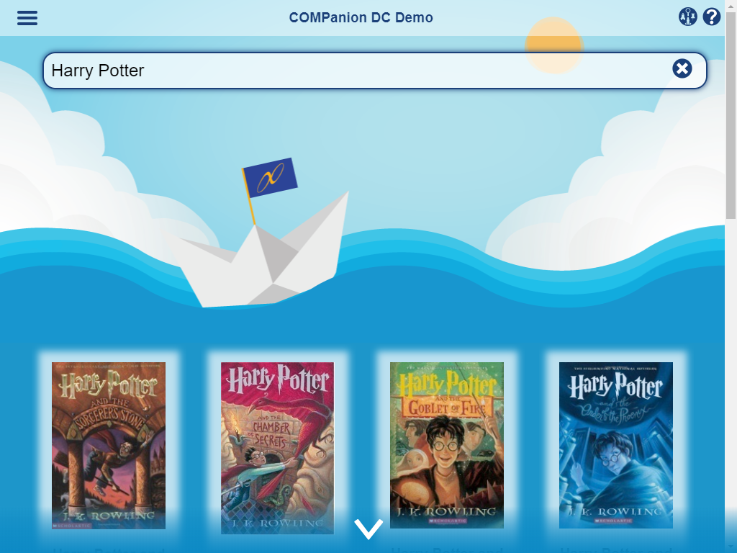
FINDING BOOKS – 200
This is the most intuitive Researcher interface.
What is Scout
Go Back

Slide 15
FINDING BOOKS – 300
This is the computer tool you use if you know the genre of the book you want to find, such as fantasy or science fiction.
What is Browse
Go Back

Slide 16
FINDING BOOKS – 400
This is where you go on the computer to find a book based on things you are interested in, such as animals, sports, or history.
What is Explore
Go Back

Slide 17
FINDING BOOKS – 500
This is how you find a book at your reading level/Lexile
What is Browse by Study Program
Go Back

Slide 18
GENRES – 100
This word is used to describe stories that were made up (never actually happened).
What is Fiction
Go Back

Slide 19
GENRES – 200
This word is used to describe books that are factual.
What is Non-Fiction
Go Back

Slide 20
GENRES – 300
This word is typically used to describe books that are about magic and imaginary creatures.
What is Fantasy
Go Back

Slide 21
GENRES – 400
This word is typically used to describe books where the plot takes place in the past, like the Civil War, although the characters and story are made up.
What is Historical Fiction
Go Back

Slide 22
GENRES – 500
This word is typically used to describe books where the plot takes place in an imagined future and/or place with technological advances. There are usually aliens and robots involved.
What is Science Fiction
Go Back

Slide 23
GENERAL – 100
This is how long you should read every day.
What is Twenty Minutes
Go Back

Slide 24
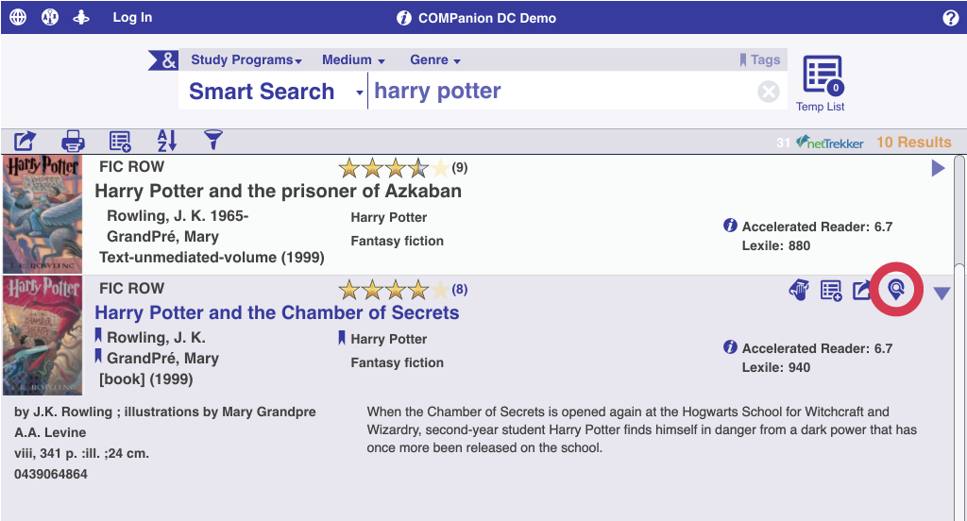
GENERAL – 200
This button shows you which shelf the selected book is in the library.
What is Maps
Go Back

Slide 25
GENERAL – 300
This is where you can go on the computer to see the latest news and important updates going on in the library and school.
What is Bulletins
Go Back

Slide 26
GENERAL – 400
This is where you can go on the computer to see what books you have checked out or reserved, what charges you have, and reviews you’ve written.
What is Patron Status
Go Back

Slide 27
GENERAL – 500
This is what you do on the computer to make sure the book you want won’t be checked out to anyone else before you get to the library.
What is Place a Hold
Go Back

Slide 28
FINAL JEOPARDY
This is what you press in the Search interface in order to refine your search by several criteria such as by author, subject, curriculum, etc.
What is The “&” Flag
Go Back

